Slide 1
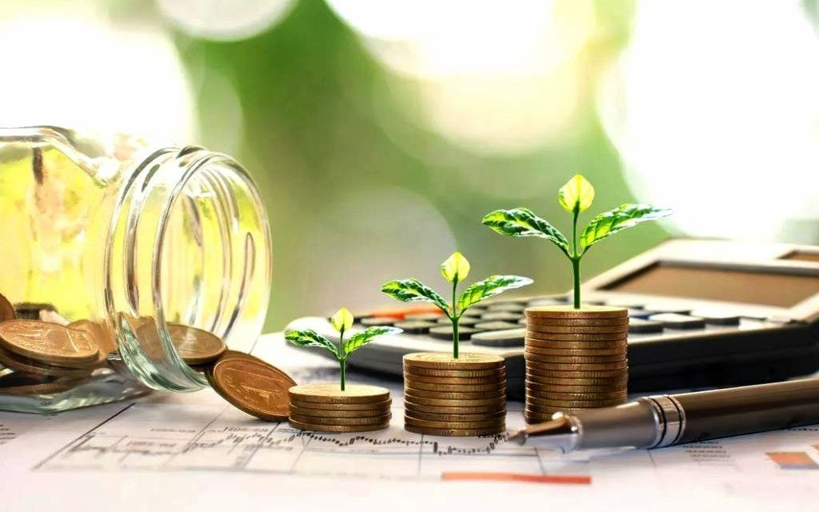
ECONOMIC GROWTH vs. ECONOMIC DEVELOPMENT
Macroeconomics

Slide 2
INTRODUCTION
ECONOMIC
GROWTH
ECONOMIC DEVELOPMENT
Refers to the increase in a country's output of goods and services over time, usually measured by GDP. It is quantitative
A broader concept that includes economic growth along with improvements in living standards, health, education, and income distribution. It is qualitative

Slide 3
Differences between Economic Growth and
Economic Development
GP
GP
Economic Growth
Economic Development
Increase in GDP or national income
Improvement in standard of living and quality of life
Quantitative
Qualitative
Production and income
Welfare, education, health, poverty reduction
Short-term
Long-term
GDP, GNP, National Income
Human Development Index (HDI), literacy, life expectancy

Slide 4
MEASUREMENT
ECONOMIC
GROWTH
ECONOMIC DEVELOPMENT
GDP (Gross Domestic Product)
GNP (Gross National Product)
Per capita income
Human Development Index (HDI)
Life expectancy & literacy rate
Poverty rate & access to basic services
Employment opportunities and social indicators

Slide 5
IMPORTANCE
ECONOMIC
GROWTH
ECONOMIC DEVELOPMENT
Increases national income and wealth
Creates employment opportunities
Encourages investment and technological advancement
Expands industrial and agricultural production
Boosts government revenue, enabling more public services
Enhances international trade and competitiveness
Improves quality of life and standard of living
Reduces poverty and income inequality
Promotes sustainable development and environmental protection
Increases access to education and healthcare
Enhances social and human capital
Strengthens infrastructure and public services

Slide 6
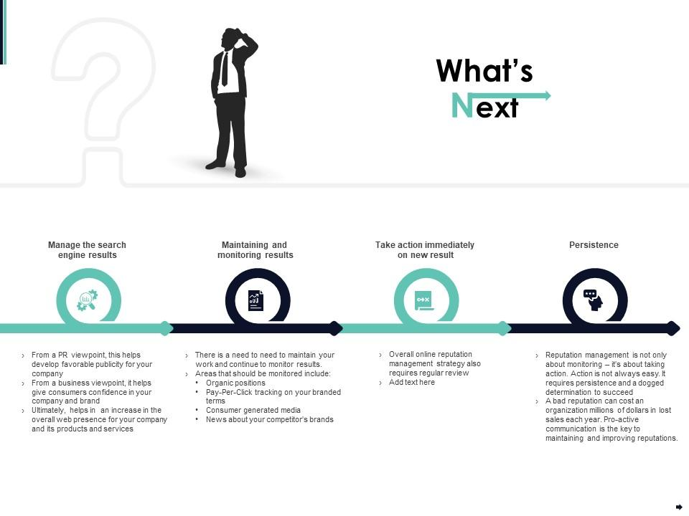
LIMITATIONS
Limitations of Economic Growth Without Development
Unequal income distribution may persist despite growth.
Environmental degradation and resource depletion may occur.
Social indicators like health and education may remain poor.
High growth can coexist with poverty and unemployment in certain sectors.

Slide 7
CONCLUSION
Concluding Economic Growth & Economic Development
Economic growth is about increasing output, while economic development is about improving overall well-being. Sustainable development requires both growth and human welfare improvements. Policymakers should focus on inclusive growth that enhances quality of life for all citizens.

Slide 8

THANK YOU.
Any Questions?

